Slide 1


Machine Learning
Efi Arazi School of Computer Science
Introduction to Computer Science
Lecture 13-1

Slide 2
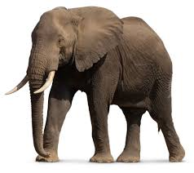
Detecting an elephant
Task: Write a program that identifies whether an elephant appears in an image.

Slide 3
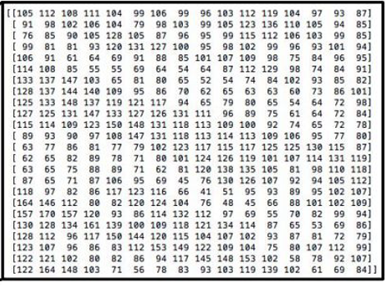
Detecting an elephant
Task: Write a program that identifies whether an elephant appears in an image.
import java.awt.Color; /** Detects an elephant in a given picture */ public class ElephantDetector {
public static void main(String[] args) {
Color[][] pic = read(“safari-1.ppm”);
if (hasElephant(pic)) {
// Do something
}
}
private static Color[][] read(String fileName) { // From HW6; code omitted
}
private static boolean hasElephant(Color[][] pic) {
// Detection code
}
}
A picture = a two-dimensional array of numbers.

Slide 4


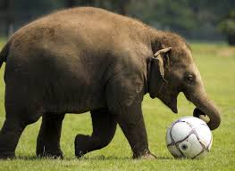


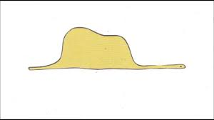
Detecting an elephant
An elephant can appear in a picture in countless ways, making the detection challenging.

Slide 5

The complexity of detecting objects
Is there an elephant in the picture?
Easy task for human, Hard for machines.

Slide 6

The complexity of detecting objects
How many chairs in the picture?
Easy task for human, Hard for machines.

Slide 7
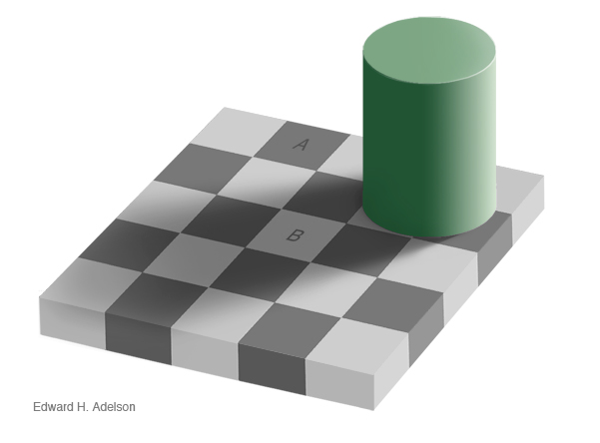
Some tasks are easier for machines than they are for humans
Boxes A and B have the same background color. True/False?
Boxes A and B have the same background color. True/False?
Hard task for humans, Easy for machines.

Slide 8
Some tasks are easier for machines than they are for humans
Boxes A and B have the same background color. True/False?
Boxes A and B have the same background color. True/False?
Hard task for humans, Easy for machines.

Slide 9
Lecture plan
Introduction
Simple predictions
Gradient Descent
Predicting many features
Neural networks

Slide 10
Let’s take a simpler problem
Task: Write a program that predicts the initial price of real estate properties.
Approach: Use a dataset of historical prices data.
property | rooms | sq. meters | price
1 | 1 | 35 | 1,000,000
2 | 1 | 30 | 750,000
3 | 1 | 32 | 725,000
4 | 1.5 | 30 | 700,000
5 | 2 | 35 | 800,000
6 | 2 | 37 | 820,000
7 | 2 | 43 | 1,050,000
8 | 2.5 | 44 | 1,000,000
9 | 2.5 | 42 | 950,000
10 | 3 | 75 | 1,200,000
11 | 3 | 65 | 1,300,000
12 | 4 | 89 | 1,250,000
Dataset
A collection of data items.
Each has features (#rooms, size), and a true target value of interest (price)
Typically stored in a file or a database.

Slide 11
Let’s take a simpler problem
Task: Write a program that predicts the initial price of real estate properties.
Approach: Use a dataset of historical prices data.
property | rooms | sq. meters | price
1 | 1 | 35 | 1,000,000
2 | 1 | 30 | 750,000
3 | 1 | 32 | 725,000
4 | 1.5 | 30 | 700,000
5 | 2 | 35 | 800,000
6 | 2 | 37 | 820,000
7 | 2 | 43 | 1,050,000
8 | 2.5 | 44 | 1,000,000
9 | 2.5 | 42 | 950,000
10 | 3 | 75 | 1,200,000
11 | 3 | 65 | 1,300,000
12 | 4 | 89 | 1,250,000
Dataset
A collection of data items.
Each has features (#rooms, size), and a true target value of interest (price)
Typically stored in a file or a database.
Task: predict the price of a new property, based on its features.
public static double predict(double numOfRooms,
double size) {
// Price prediction code
}

Slide 12
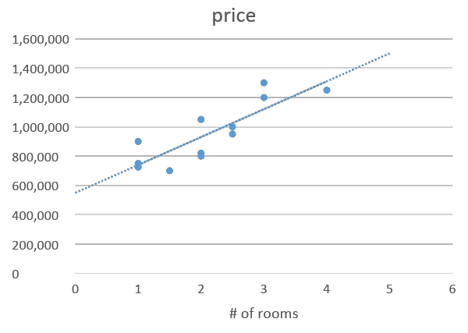
Visualization
Let’s start with one feature: number of rooms.
Can we detect an informative trend (מגמה)?
property | rooms | sq. meters | price
1 | 1 | 35 | 1,000,000
2 | 1 | 30 | 750,000
3 | 1 | 32 | 725,000
4 | 1.5 | 30 | 700,000
5 | 2 | 35 | 800,000
6 | 2 | 37 | 820,000
7 | 2 | 43 | 1,050,000
8 | 2.5 | 44 | 1,000,000
9 | 2.5 | 42 | 950,000
10 | 3 | 75 | 1,200,000
11 | 3 | 65 | 1,300,000
12 | 4 | 89 | 1,250,000

Slide 13
Visualization
Let’s start with one feature: number of rooms.
Can we detect an informative trend (מגמה)?
Observations
Properties with the same number of rooms were sold for different prices;
But, the price seems to grow linearly with the number-of-rooms feature.

Slide 14
Predicting the price of a new property
Let’s start with one feature: number of rooms.
Can we detect an informative trend (מגמה)?
Observations
Properties with the same number of rooms were sold for different prices;
But, the price seems to grow linearly with the number-of-rooms feature.
To predict the price of a new property, we can use the trend line.
But... How can we be assured that this particular line best fits the data?

Slide 15
Trending line
Line equation:
y = a x + b
slope
intersection with the y axis

Slide 16
Trending line
y = ax+b
y = ax+b’ b’ < b
Line equation:
y = a x + b

Slide 17
Trending line
y = ax+b
Line equation:
y = a x + b
y = a’x+b a’ < a

Slide 18
Many potential trending lines
Line equation:
y = a x + b
There are infinitely many possible lines;
How to determine the best-fitting trend line?

Slide 19
Finding the best trending line
Define an error measure, and select the line that has the smallest error
The error is a function of a and b.
Arrows: the errors of predicting the price of each property using this trending line

Slide 20
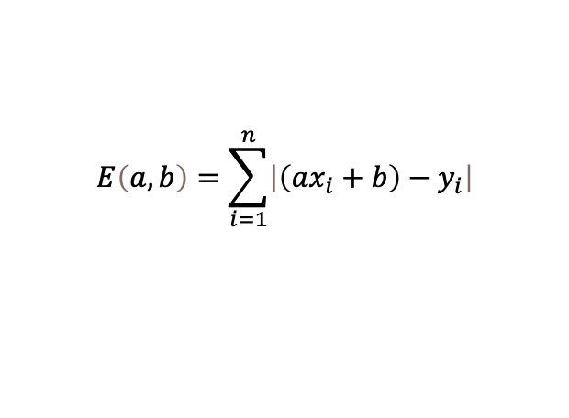
Finding the best trending line
Define an error measure, and select the line that has the smallest error
The error is a function of a and b.
For each property i, xi is the number of rooms, and yi is the price;
Therefore, the error of the line y = a x+b for property i is: | yi – a xi + b |
Collectively, for all properties in the dataset, the error is defined as:
$$E\left(a,b\right)=\sum_{i=1}^{n}{\left|\left(ax_{i}+b\right)−y_{i}\right|}$$

Slide 21
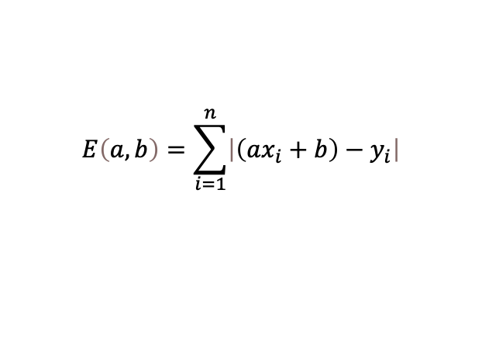
Finding the best trending line
Task: find the values of a and b that minimize the error:
$$E\left(a,b\right)=\sum_{i=1}^{n}{\left|\left(ax_{i}+b\right)−y_{i}\right|}$$
Finding the minimum of E
Compute the derivative of E with respect to a and b;
Find a and b that bring the derivative to 0.

Slide 22
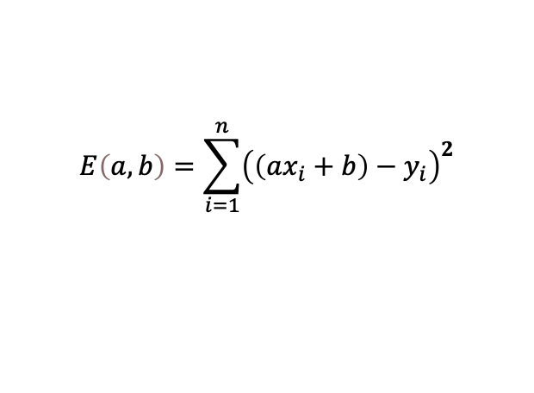
Finding the best trending line
Task: find the values of a and b that minimize the error:
$$E\left(a,b\right)=\sum_{i=1}^{n}{\left|\left(ax_{i}+b\right)−y_{i}\right|}$$
Finding the minimum of E
Compute the derivative of E with respect to a and b;
Find a and b that bring the derivative to 0.
Problem: Absolute value is not differentiable. Solution: Change “absolute error” to “square error”:
$$E\left(a,b\right)=\sum_{i=1}^{n}{{\left(\left(ax_{i}+b\right)−y_{i}\right)}^{2}}$$

Slide 23
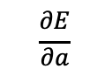
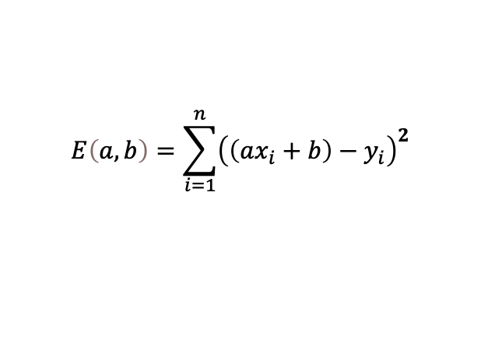

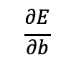
Deriving the error
Task: Finding the minimum of E:
$$E\left(a,b\right)=\sum_{i=1}^{n}{{\left(\left(ax_{i}+b\right)−y_{i}\right)}^{2}}$$
$$\frac{∂E}{∂a}$$
$$\frac{∂E}{∂b}$$
Optimal solution: Compute the two partial derivatives:
Set them to 0, and solve for a and b.
Running time:
where N is the number of data items and d is the number of features.
$$O(d^{3}+Nd^{2})$$
Gradient Descent: an approximation algorithm.
Running time: O(N)

Slide 24
Lecture plan
Introduction
Simple predictions
Gradient Descent
Predicting many features
Neural networks

Slide 25
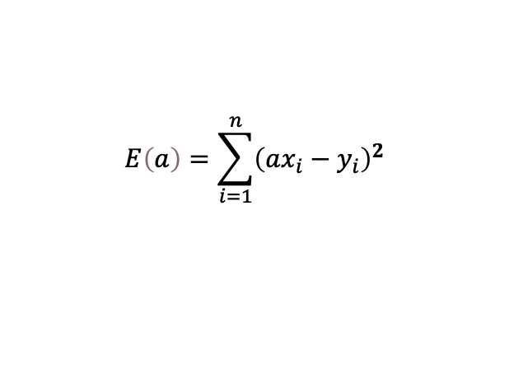
Gradient Descent (General Idea)
Let’s ignore b for now, and find a that minimizes:
Algorithm:
Initialize a to a random value
for t = 1 … T :
change a according to an update rule.
$$E\left(a\right)=\sum_{i=1}^{n}{{\left(ax_{i}−y_{i}\right)}^{2}}$$

Slide 26
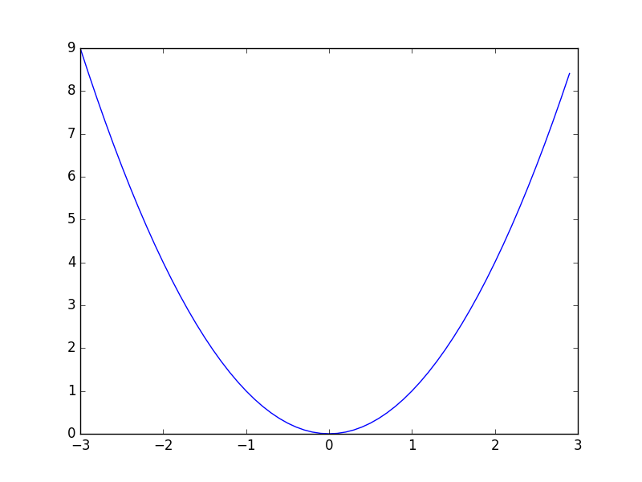
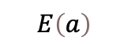


Gradient Descent (General Idea)
Algorithm:
Initialize a to a random value
for t = 1 … T :
change a according to an update rule.
?
$$E\left(a\right)$$
Random value
$$a$$
$$E\left(a\right)=\sum_{i=1}^{n}{{\left(ax_{i}−y_{i}\right)}^{2}}$$

Slide 27
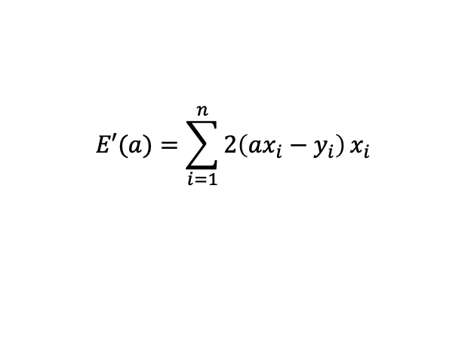

Gradient Descent (General Idea)
Algorithm:
Initialize a to a random value
for t = 1 … T :
change a according to an update rule.
E’(2) is the slope of the
tangent line (משיק) at a=2
$$E\left(a\right)$$
$$a$$
$$E\left(a\right)=\sum_{i=1}^{n}{{\left(ax_{i}−y_{i}\right)}^{2}}$$
$$E′(a)=\sum_{i=1}^{n}{2\left(ax_{i}−y_{i}\right)}x_{i}$$

Slide 28
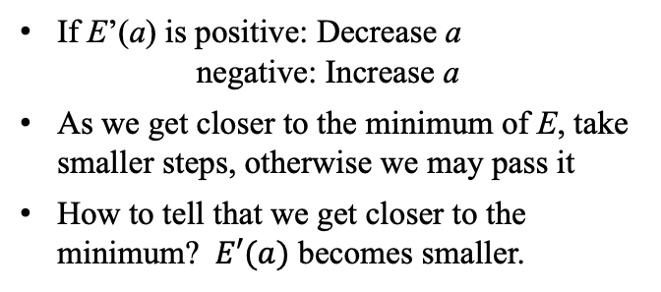
Gradient Descent (General Idea)
Algorithm:
Initialize a to a random value
for t = 1 … T :
change a according to an update rule.
E’(2) is the slope of the
tangent line (משיק) at a=2
If E’(a) is positive: Decrease a negative: Increase a
As we get closer to the minimum of E, take smaller steps, otherwise we may pass it
How to tell that we get closer to the minimum? $E′(a)$ becomes smaller.
$$E\left(a\right)$$
$$a$$
$$E\left(a\right)=\sum_{i=1}^{n}{{\left(ax_{i}−y_{i}\right)}^{2}}$$
$$E′(a)=\sum_{i=1}^{n}{2\left(ax_{i}−y_{i}\right)}x_{i}$$

Slide 29
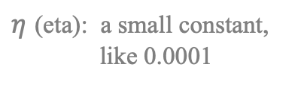

Gradient Descent (General Idea)
Algorithm:
Initialize a to a random value
for t = 1 … T :
change a according to an update rule.
E’(2) is the slope of the
tangent line (משיק) at a=2
If E’(a) is positive: Decrease a negative: Increase a
As we get closer to the minimum of E, take smaller steps, otherwise we may pass it
How to tell that we get closer to the minimum? $E′(a)$ becomes smaller.
$$E\left(a\right)$$
$$a$$
Update rule:
$$E\left(a\right)=\sum_{i=1}^{n}{{\left(ax_{i}−y_{i}\right)}^{2}}$$
$$a=a − ηE′(a)$$
$η$ (eta): a small constant, like 0.0001
$$E′(a)=\sum_{i=1}^{n}{2\left(ax_{i}−y_{i}\right)}x_{i}$$

Slide 30
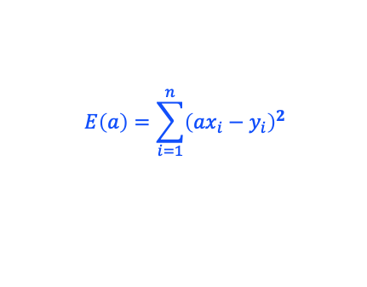
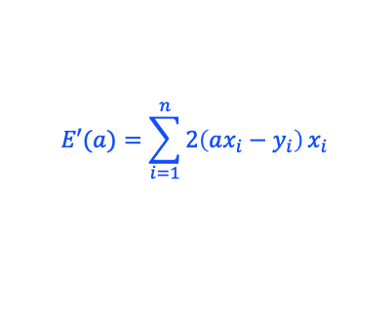
Gradient Descent –implementation
/* Trains the model, finds an estimate of the slope (computes a, a static variable).
public static void train(double[] x, double[] y, int T, double learningRate) {
a = Math.random();
for (int t = 0; t < T; t++) {
// Calculates the error
double e = error(x, y);
System.out.println("Error in iteration " + t + " is " + e);
// Update rule
a -= learningRate * derivativeAt(x, y);
}
}
// Computes the total square error of the model for the given dataset
private static double error(double[] x, double []y) {
double e = 0;
for (int i = 0; i < x.length; i++) {
e += Math.pow(a * x[i] - y[i], 2);
}
return e;
}
// Computes the derivative value of the error
private static double derivativeAt(double[] x, double []y) {
double e = 0;
for (int i = 0; i < x.length; i++) {
e += 2 * (a * x[i] - y[i]) * x[i];
}
return e;
}
$$E\left(a\right)=\sum_{i=1}^{n}{{\left(ax_{i}−y_{i}\right)}^{2}}$$
$$E′(a)=\sum_{i=1}^{n}{2\left(ax_{i}−y_{i}\right)}x_{i}$$

Slide 31
Gradient Descent –implementation
/* Trains the model, finds an estimate of the slope (computes a, a static variable).
public static void train(double[] x, double[] y, int T, double learningRate) {
a = Math.random();
for (int t = 0; t < T; t++) {
// Calculates the error
double e = error(x, y);
System.out.println("Error in iteration " + t + " is " + e);
// Update rule
a -= learningRate * derivativeAt(x, y);
}
}
// Computes the total square error of the model for the given dataset
private static double error(double[] x, double []y) { // Code omitted }
// Computes the derivative value of the error
private static double derivativeAt(double[] x, double []y) { // Code omitted }
public static double predict(double x) {
return a * x;
}
public static void main(String []args) {
double[] x = {1, 1, 1, 1.5, 2, 2, 2, 2.5, 2.5, 3, 3, 4};
double[] y = {1000000, 750000, 725000, 700000, 800000, 820000, 1050000, 1000000, 950000, 1200000, 1300000, 1250000};
train(x, y, 10, 0.01);
System.out.println(a);
System.out.println("Price of a 2.5 room property:" + predict(2.5));
}
// Output
Error in iteration 0: 1.1587977732925691E13
Error in iteration 1: 1.604226225427505E12
Error in iteration 2: 8.49205017672955E11
Error in iteration 3: 7.921065388365171E11
Error in iteration 4: 7.877884663745115E11
Error in iteration 5: 7.874619121445724E11
Error in iteration 6: 7.87437216480933E11
Error in iteration 7: 7.874353488713704E11
Error in iteration 8: 7.874352076333975E11
Error in iteration 9: 7.874351969522759E11
411606.82499226247
Price of a 2.5 room property:1029017.06

Slide 32
Recap: Using Machine Learning (ML) terminology
Data items (Gold Standard) (e.g., examples of properties with prices)
Train
Model (e.g., a and b for a trending line)
Unseen data item (e.g., # of rooms)
Target (e.g., price)
Predict

Slide 33
Lecture plan
Introduction
Simple predictions
Gradient Descent
Predicting many features
Neural networks

Slide 34
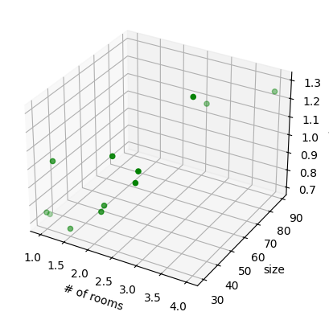
Predicting with many features
We can extend this algorithm to fit a model for items with multiple features.
Example: number of rooms and size (in sq. meter)
Task: Fit a plane (instead of a line).
Now we have two coefficients, one for each axis. We can add more features like that.
y = a x₁ + b x₂ + c
property | rooms | sq. meters | price
1 | 1 | 35 | 1,000,000
2 | 1 | 30 | 750,000
3 | 1 | 32 | 725,000
4 | 1.5 | 30 | 700,000
5 | 2 | 35 | 800,000
6 | 2 | 37 | 820,000
7 | 2 | 43 | 1,050,000
8 | 2.5 | 44 | 1,000,000
9 | 2.5 | 42 | 950,000
10 | 3 | 75 | 1,200,000
11 | 3 | 65 | 1,300,000
12 | 4 | 89 | 1,250,000

Slide 35
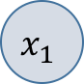
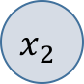
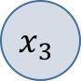
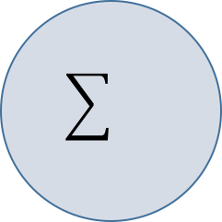
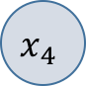
Artificial neuron
We may use more than two features, and visualize this equation as a graph:
y = w₁ x₁ + w₂ x₂ +…+ b
Changing the notation
w1
w2
w3
w4
y
wn
…
b
xd
“weights”

Slide 36
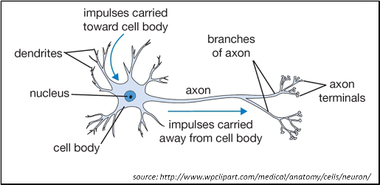
Artificial neuron
A simplified model of the function of a biological neuron:
y = w₁ x₁ + w₂ x₂ +…+ b
w1
w2
w3
w4
y
wn
…
xd
b

Slide 37
Lecture plan
Introduction
Simple predictions
Gradient Descent
Predicting many features
Neural networks

Slide 38
Neural network
As in biological neurons, we can combine neurons to handle complex tasks.
y1
…
xd
The neuron is used to process the features of the input x

Slide 39
Neural network
As in biological neurons, we can combine neurons to handle complex tasks.
y1
y2
…
xn
Using two neurons to process the features of the input x

Slide 40
Neural network
As in biological neurons, we can combine neurons to handle complex tasks.
y1
y2
y3
…
xn
We can add as many neurons as we like (cleverly)
Each neuron may provide a different perspective on the data.

Slide 41
Neural network
Two-layer neural network
y
…
xn
1st layer
2nd layer
Other network architectures are used, for different applications.

Slide 42
Back-propagation
Training a neural network: We need to use an extended version of gradient descent, since we need to propagate the error from the 2nd layer to the 1st layer.
Backpropagation: Covered in other courses, stay tuned.
y
…
xn
1st layer
2nd layer

Slide 43
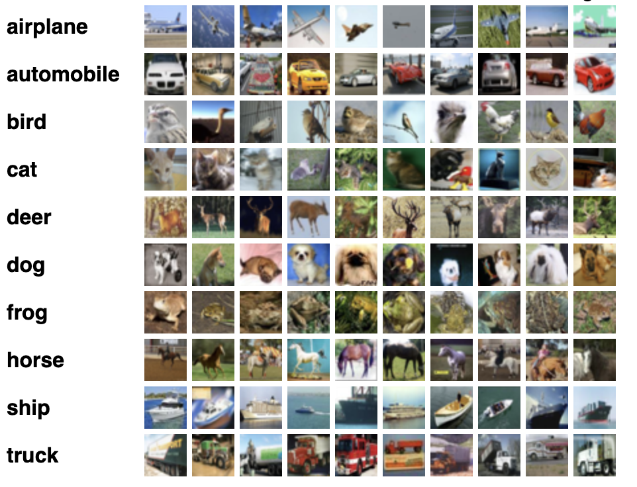
Neural network: Classification
Example: The CIFAR-10 dataset consists of 32x32 color images, classified into 10 classes, with 6000 images per class. There are 50000 training images and 10000 test images.
The task: Detect the object in the image.

Slide 44
Neural network: Classification
Example: The CIFAR-10 dataset consists of 32x32 color images, classified into 10 classes, with 6000 images per class. There are 50000 training images and 10000 test images.
The task: Detect the object in the image.
Approach: Train a network with 1024 inputs (32x32 pixels) and 10 outputs (one for each class).
y1
y2
y3
…
…
x1024
y10

Slide 45

Neural network: Classification
During training, we fit the weights to predict 1 for the correct class, and 0 for the other classes.
y1
0
y2
1
y3
0
…
…
…
x1024
y10
0

Slide 46
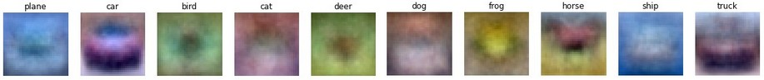
What does the network learn?
Focusing on one neuron (when training is completed):
The number of weights the neuron has is 1024 (32x32).
We can re-arrange the weights as a two-dimensional array, getting an image:
y1
0
y2
1
y3
0
…
…
…
x1024
y10
0

Slide 47
What does the network learn?
If we do this for each neuron, we get:
y1
y2
y3
…
…
x1024
y10
The network learned the “average” picture for every object.

Slide 48
Back to elephant detection
We use a similar technique.

Slide 49
This is just the beginning…
What if the best fitting curve is not a linear line? (non-linear models)
We can try building better models (smaller errors) using > 2 layers (deep learning)
We can improve gradient descent (and back propagation) by introducing different techniques for controlling the learning speed.
How many examples are needed to train a good model?
We can start the training with weights initialized by another model (transfer learning)
We can explore different applications / domains
Covered in the course Machine Learning, so stay tuned.

Slide 50
Machine Learning
Efi Arazi School of Computer Science
Introduction to Computer Science
Shimon Schocken
Lecture 12-1

